Slide 2
Time response Analysis
30.1.25

Slide 3
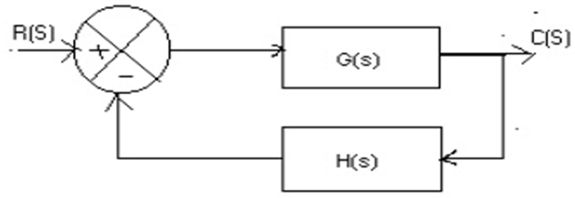

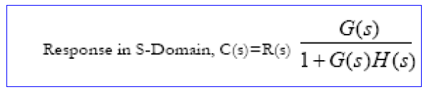
Time Response of the Control Systems

Slide 4
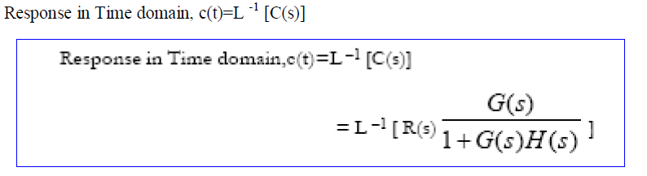
Time Response of the Control Systems

Slide 5
Standard test signals are: Step signal, Ramp signal, Parabolic signal, Impulse signal.
Why we have to go for test signals?
The answer is that the
Knowledge of input signal is required to predict the response of a system.
In most of the systems the input signals are not known ahead of time ,…. also it is difficult to express the input signals mathematically by simple equations.
Normally the characteristics of actual input signals are:
a sudden shock,
a sudden change,
a constant velocity and
a constant acceleration.
Test signals resembles these characteristics are used as input signals to predict the performance of the system.

Slide 6
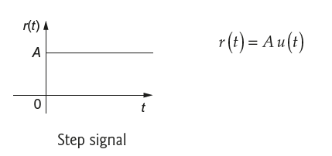
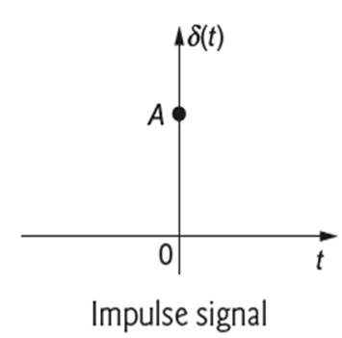
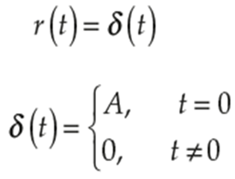
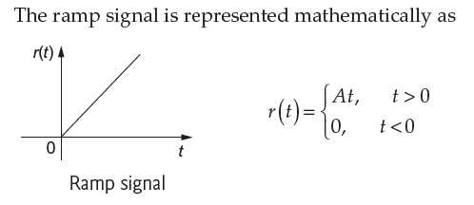
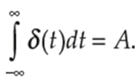
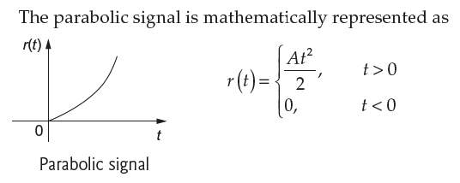
Step signal, Ramp signal, Parabolic signal & Impulse signal

Slide 7
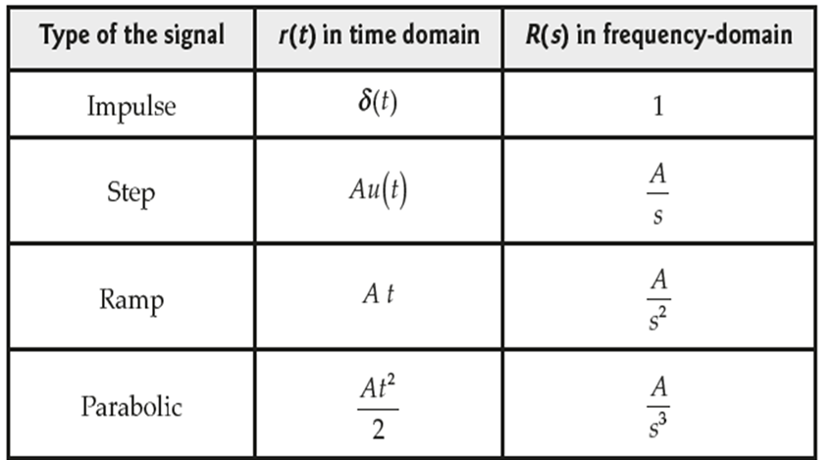
Standard test signals..

Slide 8



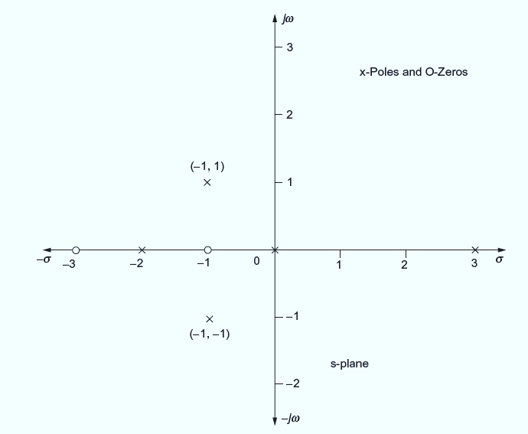
TF.. →

Slide 9
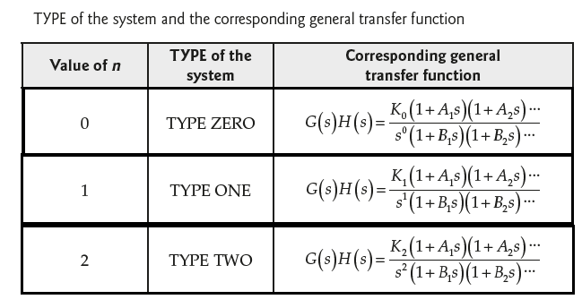
Type of the System

Slide 10
Order of the System
The order of the system is given by the maximum power of s in the denominator polynomial, Q(s).
Then n is the order of the system
If n = 0, then the system is zero order system.
If n = 1, then the system is first order system and so on.
The order can be specified for both open loop system and closed loop system.
Also the value of n gives the number of poles in the transfer function.
Hence the number of poles of the transfer function gives the order.

Slide 11
Time response analysis

Slide 13
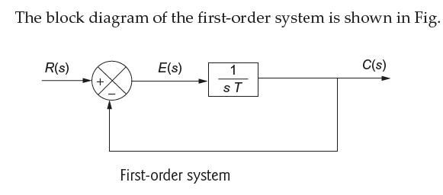
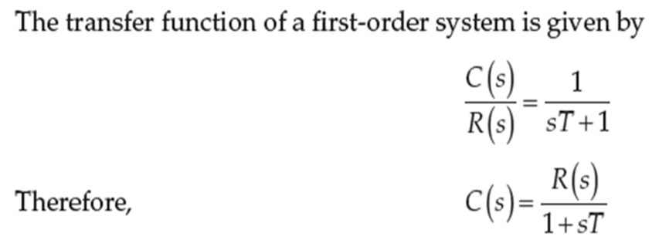
Transfer Functions of I Order System

Slide 14
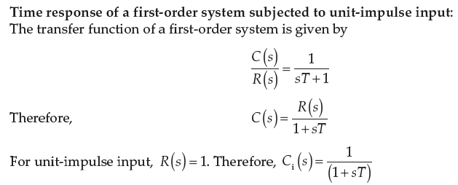
Impulse Response of I Order Systems

Slide 15
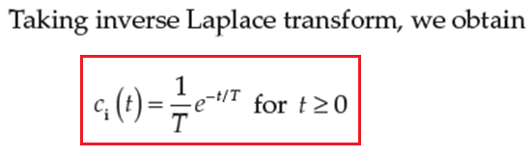
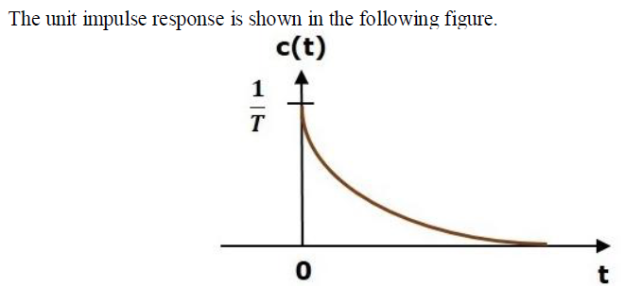
Impulse Response of I Order Systems

Slide 16
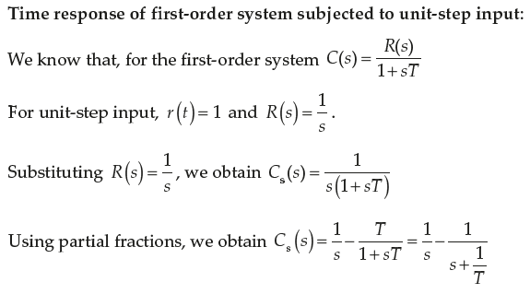
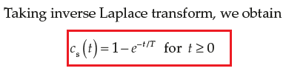
Step Response of I Order Systems

Slide 17
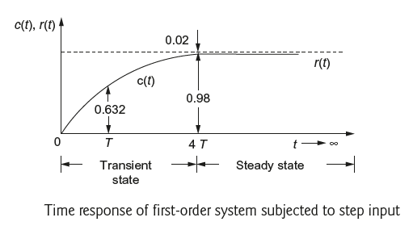
Step Response of I Order Systems

Slide 18
II order system

Slide 19
Introduction – 2nd order system
The most practical standard is to start with the system at rest & so the output & all the time derivatives before t = 0 will be zero.
(For a II order systems) The transient response of a practical control system often exhibits damped oscillations before reaching steady state.
Systems with energy storage elements cannot respond instantaneously and will exhibit transient responses, whenever they are subjected to inputs or disturbances.
The desired performance characteristics of a system of any order may be specified in terms of the transient response to a unit step input signal.

Slide 20
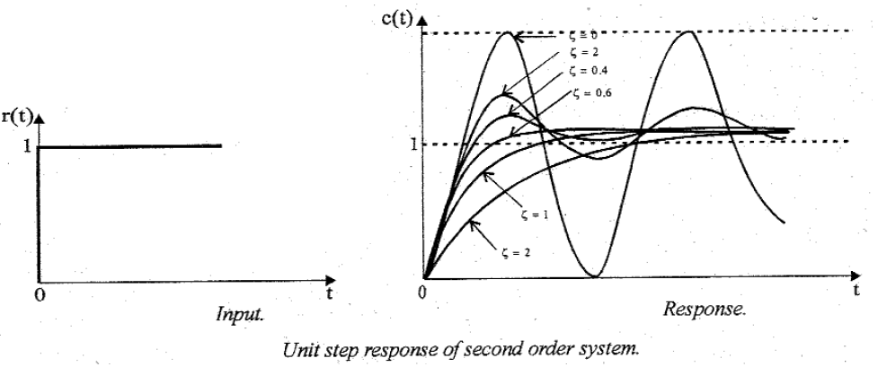
Introduction – 2nd order system
The response of a second order system for unit step input with various values of damping ratio is shown below

Slide 21
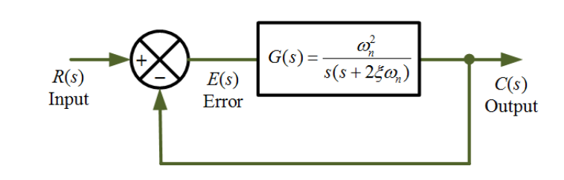




Transfer Function of II Order System

Slide 22
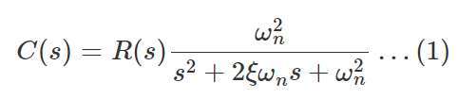


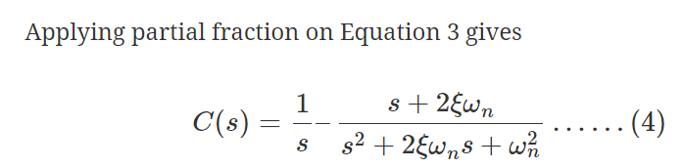

To find the response for a unit step input

Slide 23


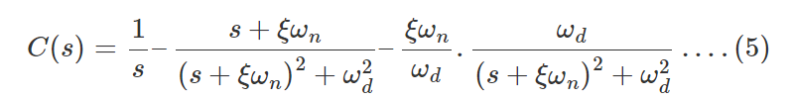
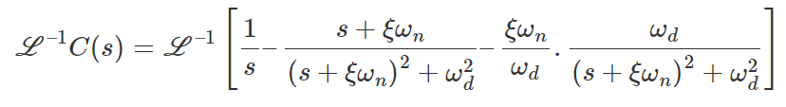
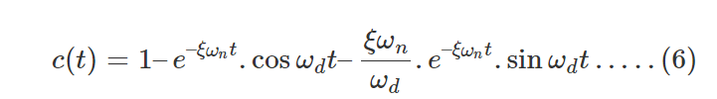

Slide 24
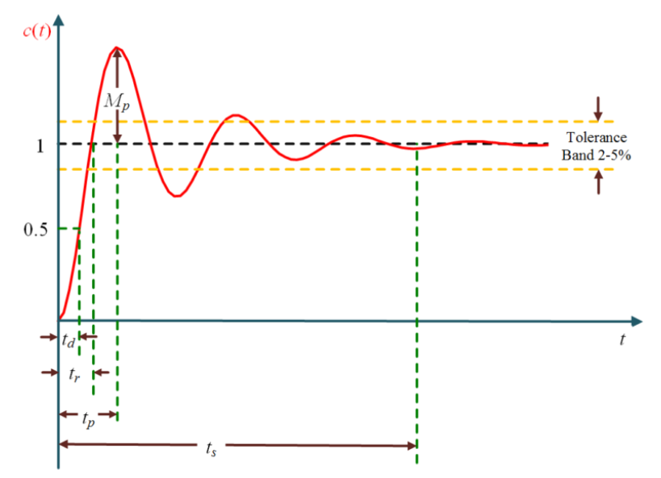
Step response of a II Order under damped System with TD spec. illustrations

Slide 25
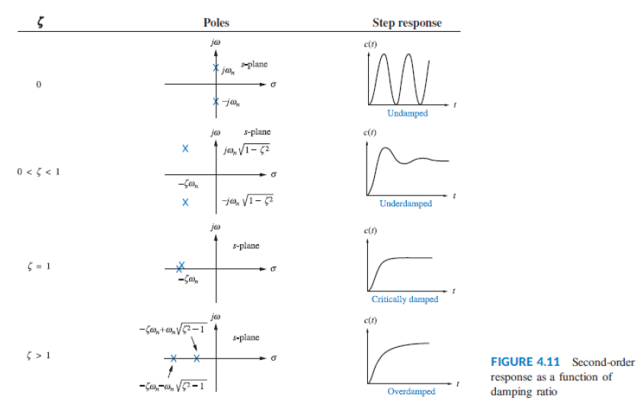
Plot for types of II Order System as a fn. of damping ratio

Slide 26
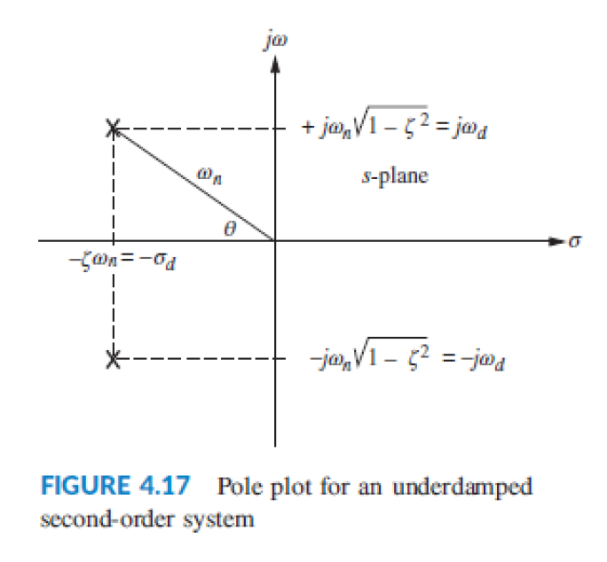
Pole – zero plot for II Order under damped System

Slide 27
EFFECTS OF POLES TO A II ORDER SYSTEM
POLES → THE SPEED OF RESPONSE, WHEEAS THE ZEROS WILL ADD OVERSHOOT IN THE RESPONSE.

Slide 28
SUMS to do..
The OLTF of a UFB system is given by
Obtain the response of the system, when the input is unit-step input.

Slide 29
SUMS to do..
Determine the response of the system, for unit-step input whose CLTF is

Slide 30
SUMS to do..
Find the unit-impulse response of the system, whose TF is given by

